Slide 1
c
キラーT細胞
くまもと免疫統合医療クリニック

Slide 2
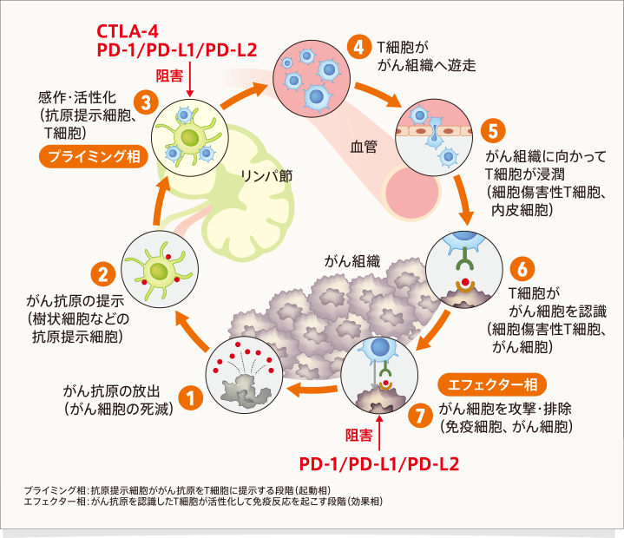
CTLA-4
Ipilimumab (ヤーボイ)
④ T細胞が
血管内を遊走
inhibition
③ 樹状細胞と
T細胞の接触
vessels
⑤ T細胞が
がん組織に浸潤
Lymph node
プライミング相
がん免疫サイクル
MDSC
MDSC
Treg
Cancer tissue
(VEGF)
Good がん免疫サイクル
(20 ~30%)
② 樹状細胞
がん抗原を提示
⑥ T細胞が
がん細胞を認識
MDSC
Treg
① がん細胞の破壊
エフェクター相
inhibition
⑦ T細胞が
がん細胞を攻撃する
PD-1/PDL-1
Nivolumab (オプジーボ)
2
Notes:
The chart is called as cancer immune circle. There are seven gates from destroy of cancer cells, activation of cytotoxic T cells, and to the contact of active T cells with cancer cells. Opdivo works at the No 7 gate, and so opdivo can not work if any gate of seven gates is impaired. It is very important for opdivo to work that cancer immune circle is going well.

